Slide 1
Simple Machines

Slide 2
Review
What are the six simple machines?

Slide 3
Review

Slide 4
Review
What is a simple machine?

Slide 5
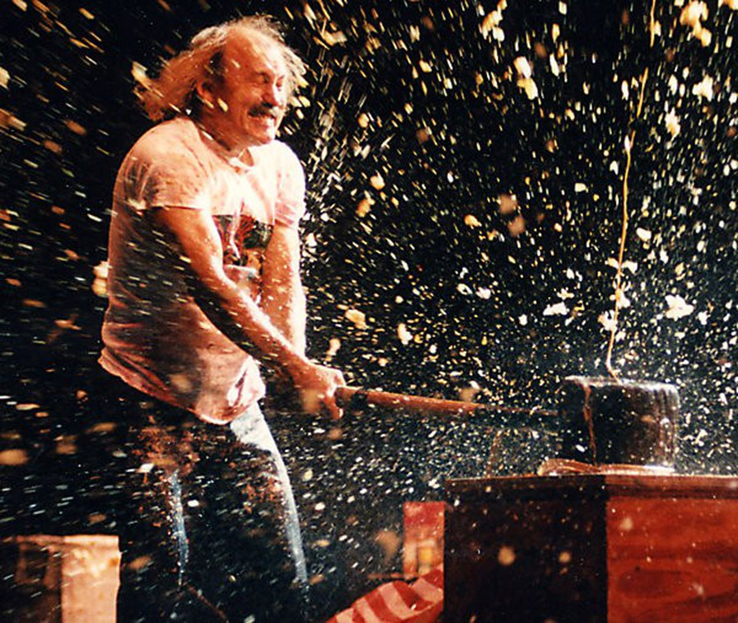
Review
Simple machines make work easier. They have few or no moving parts and they work by changing the direction of a force or the amount of force needed to do something

Slide 6
Review
What is force?

Slide 7
Review
Force is a push or pull upon an object resulting from the object's interaction with another object.

Slide 8
Review
What is work?

Slide 9
Review
Work is the transfer of mechanical energy from one object to another.
Scientifically, for work to be done, these criteria must be met:
The object moves when force is applied
The direction of the object's motion is the same as the direction of the force applied.
Work= Force x Distance

Slide 10
Review
What is friction?

Slide 11
Review
Friction is the force felt between two surfaces when one attempts to slide against the other — whether or not they are moving.
Some of the energy or force put into a machine will be diverted into friction.

Slide 12
Review
What is mechanical advantage?

Slide 13
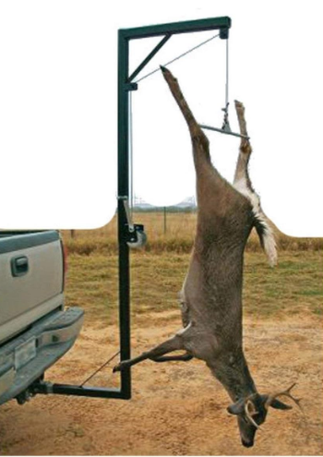
Review
Mechanical Advantage is a measure of how much a force is increased by using a tool or machine. It is equal to the force exerted by the tool or machine divided by the applied effort.

Slide 14
Review
What is an Inclined Plane?

Slide 15
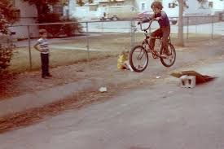
Review
An Inclined Plane is a plane surface set at an angle, other than a right angle, against a horizontal surface.
It is a ramp that assists moving heavy objects up and down heights.

Slide 16
Review
What is a Screw?

Slide 17
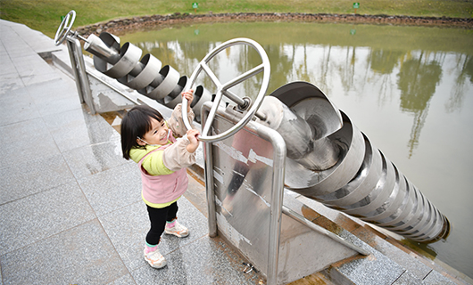
Review
A Screw is an inclined plane wrapped around a cylinder.

Slide 18
Review
What is a Wheel and Axle?

Slide 19
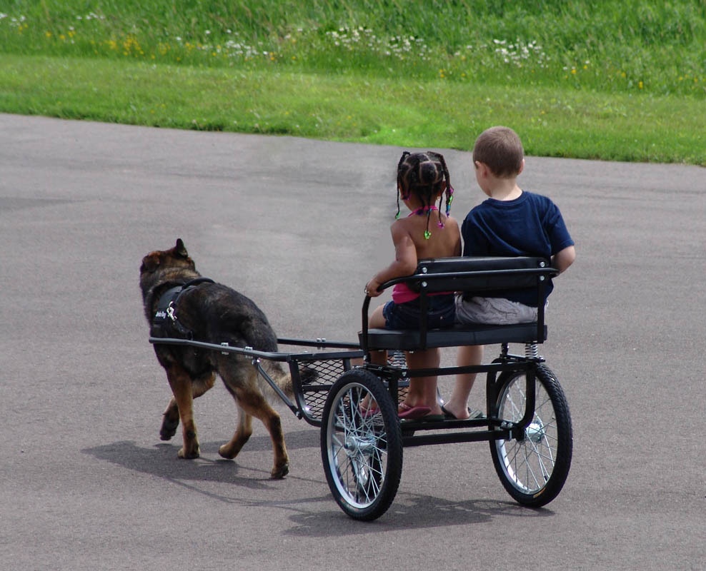
Review
A Wheel and Axle is a round disk with a rod through the center.

Slide 20
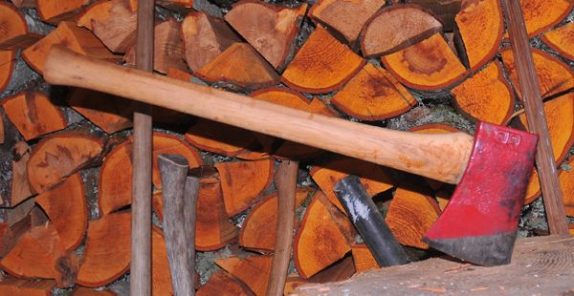
Wedge

Slide 21
What is a Wedge?
A Wedge is a pair of inclined planes that meet at a point.
It is used to separate two objects, or portions of objects, from one another.

Slide 22
How is this different than an Inclined Plane?
Inclined Plane | Wedge
Stationary | Moves
Force is applied parallel to the incline | Force is applied to the base

Slide 24
Examples of Wedges

Slide 25
What is a wedge?

Slide 26
Examples of Wedges

Slide 27
Examples of Wedges

Slide 28
Examples of Wedges

Slide 29
Examples of Wedges

Slide 30
Examples of Wedges

Slide 31
Examples of Wedges

Slide 32
Examples of Wedges

Slide 33
Math!!
To calculate the Ideal Mechanical Advantage of a wedge, you need only divide the Length of the wedge by the Thickness.
IMA = Length/Thickness
Thickness
Length

Slide 34
Next Week
Lever

