Slide 1
Simple Machines

Slide 2
Review

Slide 3
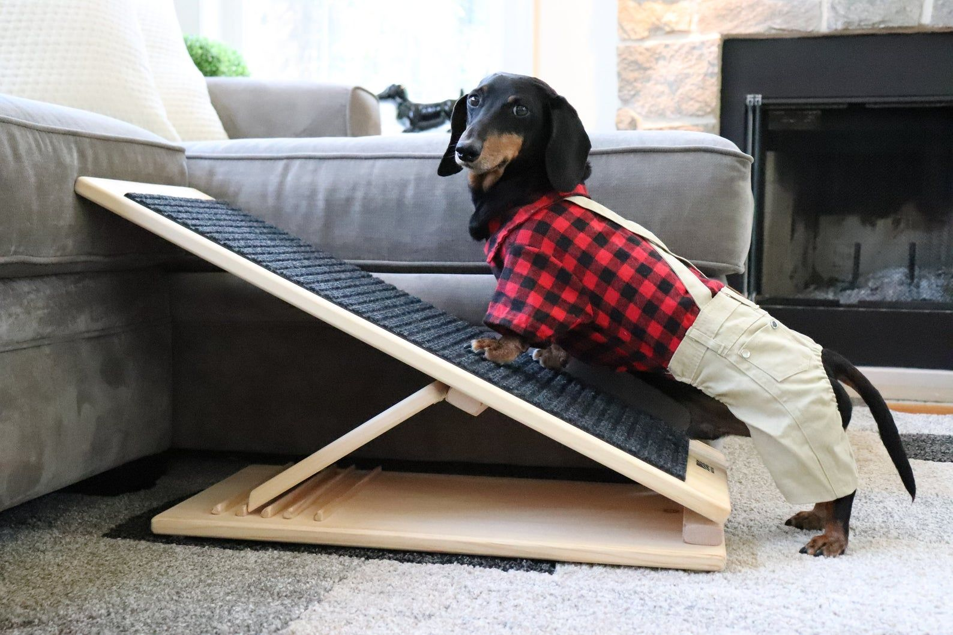
Review
Simple machines make work easier. They have few or no moving parts and they work by changing the direction of a force or the amount of force needed to do something

Slide 4
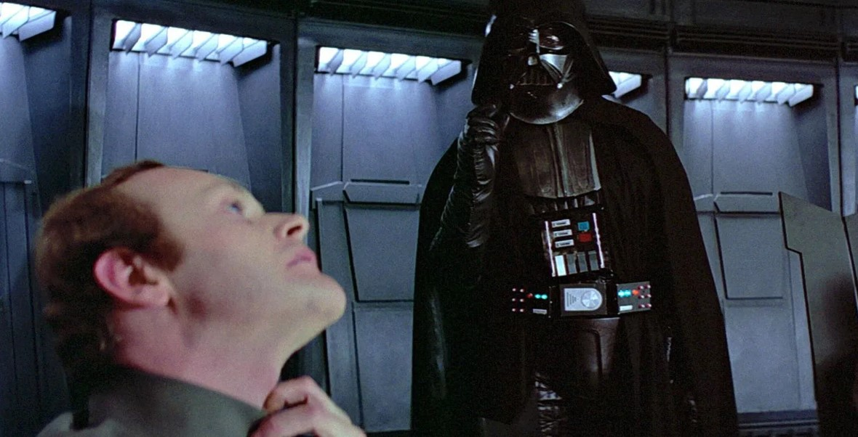
Review
Force is a push or pull upon an object resulting from the object's interaction with another object.

Slide 5
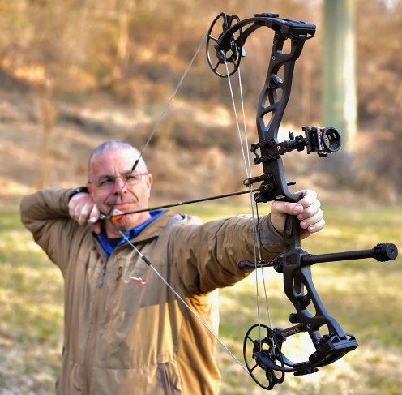
Review
Work is the transfer of mechanical energy from one object to another.

Slide 6
Review
Friction is the force felt between two surfaces when one attempts to slide against the other — whether or not they are moving.
Some of the energy or force put into a machine will be diverted into friction.

Slide 7
Review
Mechanical Advantage is a measure of how much a force is increased by using a tool or machine. It is equal to the force exerted by the tool or machine divided by the applied effort.

Slide 8
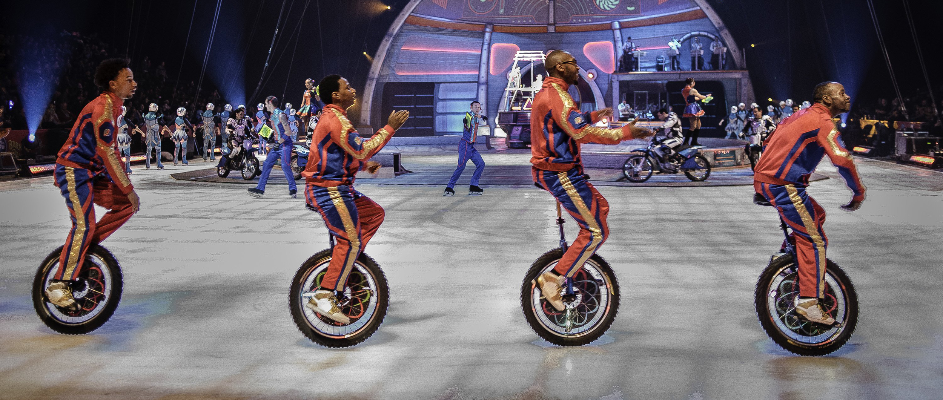
Wheel and Axle

Slide 9
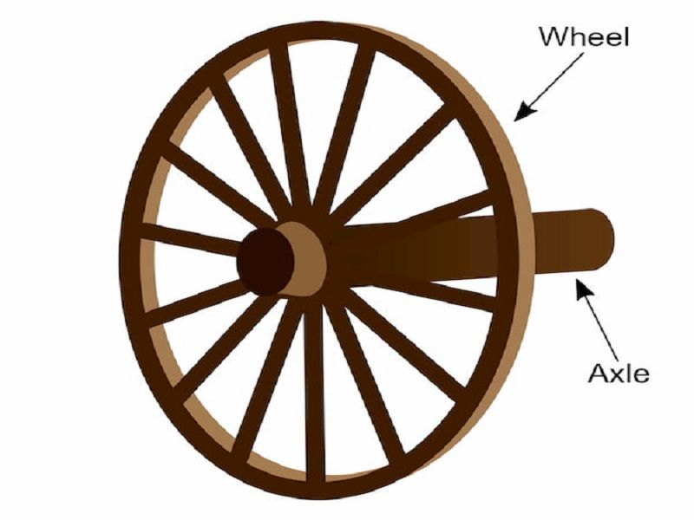
What is a Wheel and Axle?
A Wheel and Axle is a round disk with a rod through the center.
The disk is the Wheel, and the rod is the Axle.

Slide 10
Examples of Wheel and Axle

Slide 11
Examples of Wheel and Axle

Slide 12
Examples of Wheel and Axle

Slide 13
Examples of Wheel and Axle

Slide 14
Examples of Wheel and Axle

Slide 15
Examples of Wheel and Axle

Slide 16
Examples of Wheel and Axle

Slide 17
Examples of Wheel and Axle

Slide 18
Examples of Wheel and Axle

Slide 19
Examples of Wheel and Axle

Slide 20
Examples of Wheel and Axle

Slide 21
Examples of Wheel and Axle

Slide 22
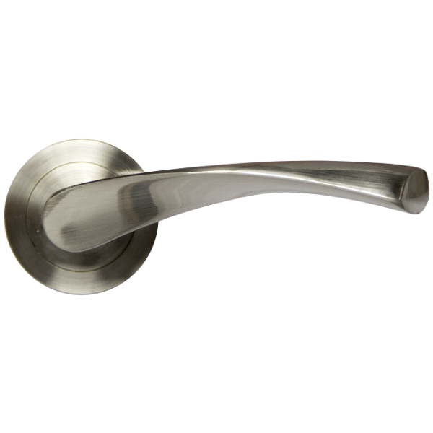
Mechanical Advantage
Ideal Mechanical Advantage (IMA) = In/Out
In a Wheel and Axle setup, this translates to:
Radius In/ Radius Out
In
Out

Slide 23
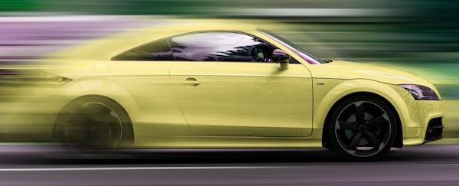
Traction vs Friction
Traction is the Friction between a drive wheel and the road surface.
Without Traction, the wheel would just spin in place.

Slide 24
Traction vs Friction

Slide 25
Next week
-Wedge

